Slide 1
Vegetation zones

Slide 2
Vegetation mainly depends on a) the latitude of a region and b) the local conditions, namely wind, moisture, rain etc. Latitude determines the temperature and the altitude of the region.

Slide 3
Flora and vegetation influence the fauna of a region, that is the animals that live there in a specific time period.

Slide 4
Why does the fauna of a region directly depend on its flora? Animals depend on plants. All living things depend on non living things. BUT: Living things depend on each other, too. Plants and animals also depend on each other for their survival.

Slide 5
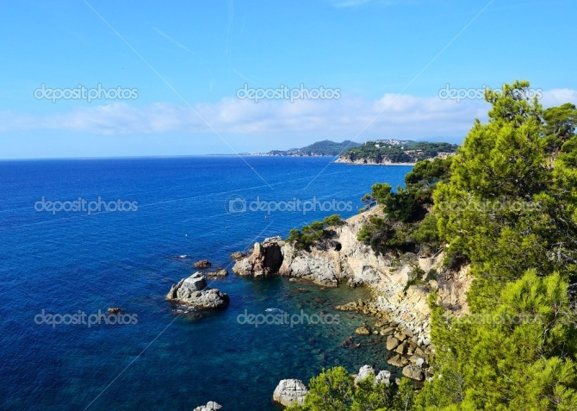
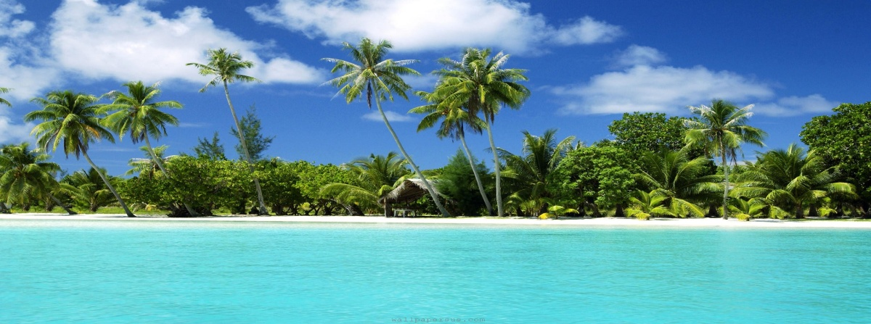
Name the landscapes

Slide 6
Climate zones

Slide 8
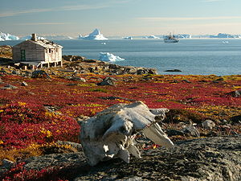
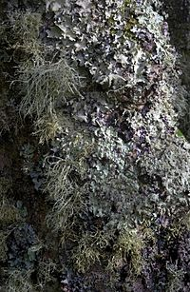
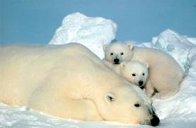
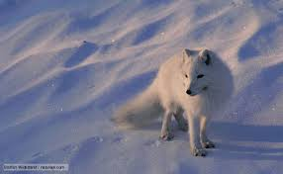
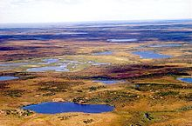
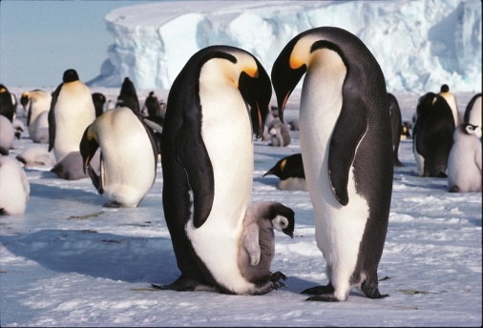
POLAR ZONE

Slide 9
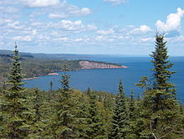
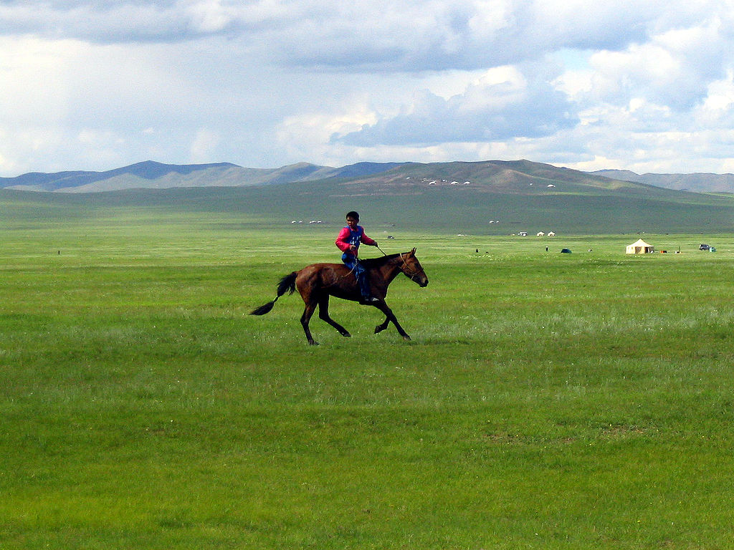
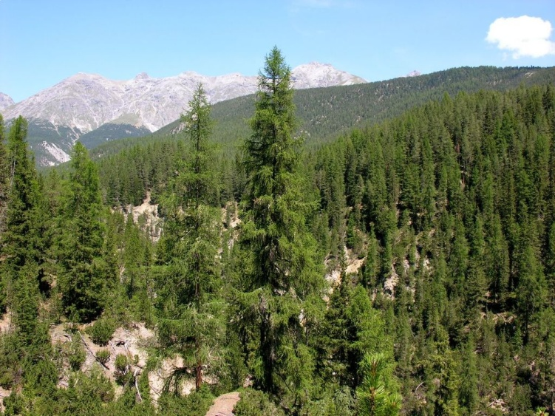
TEMPERATE ZONE

Slide 10
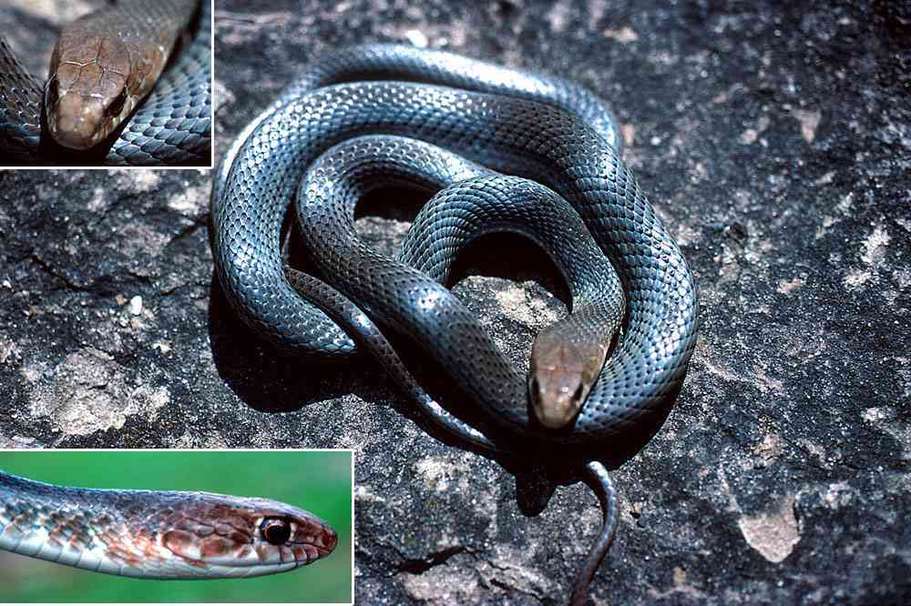
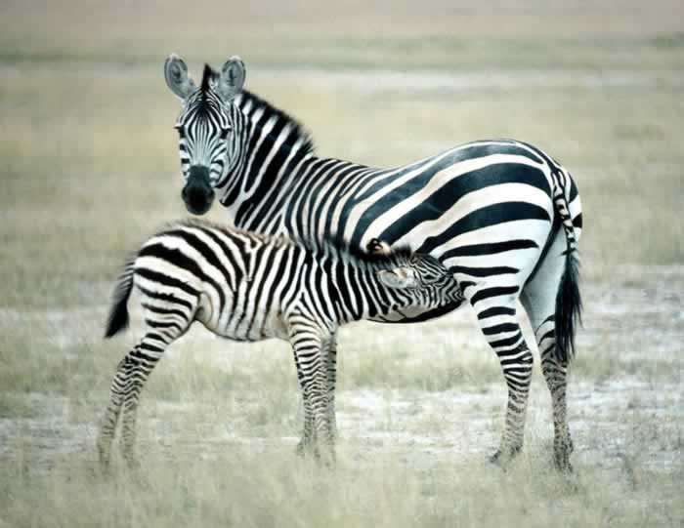
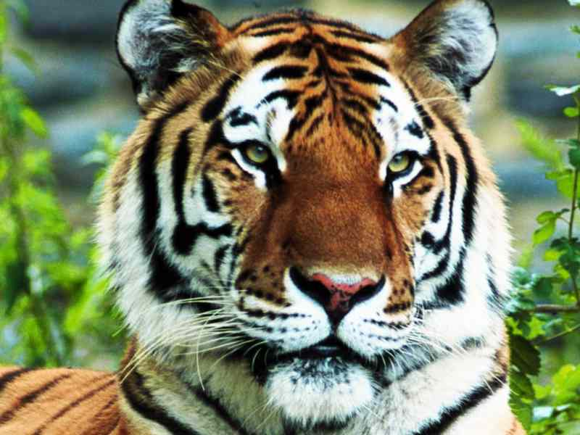
TROPICAL ZONE

Slide 11
Geographic glossary
Vegetation: how plants grow in a region /βλάστηση/
Moss: small, flowerless plants that grow in dense (πυκνός) green clumps (συστάδα) in damp (υγρός) or shady (σκιερός) locations /βρύα/
Lichen: tiny leafless branching shrub (θάμνος) /λειχήνες/
Fauna: the animal life of a region /πανίδα/
Flora: the plant life occurring in a particular region or time /χλωρίδα/
Plant formations: type of vegetation characteristic of a region /φυτική διάπλαση/

