Slide 1
FOOD GUIDE PYRAMID

Slide 2
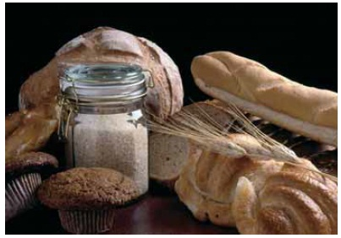
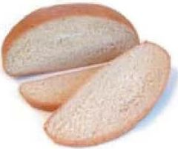
KORNFLAKES

Slide 3
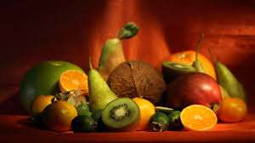
FRUIT

Slide 4
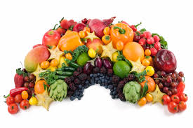
VEGETABLES

Slide 5
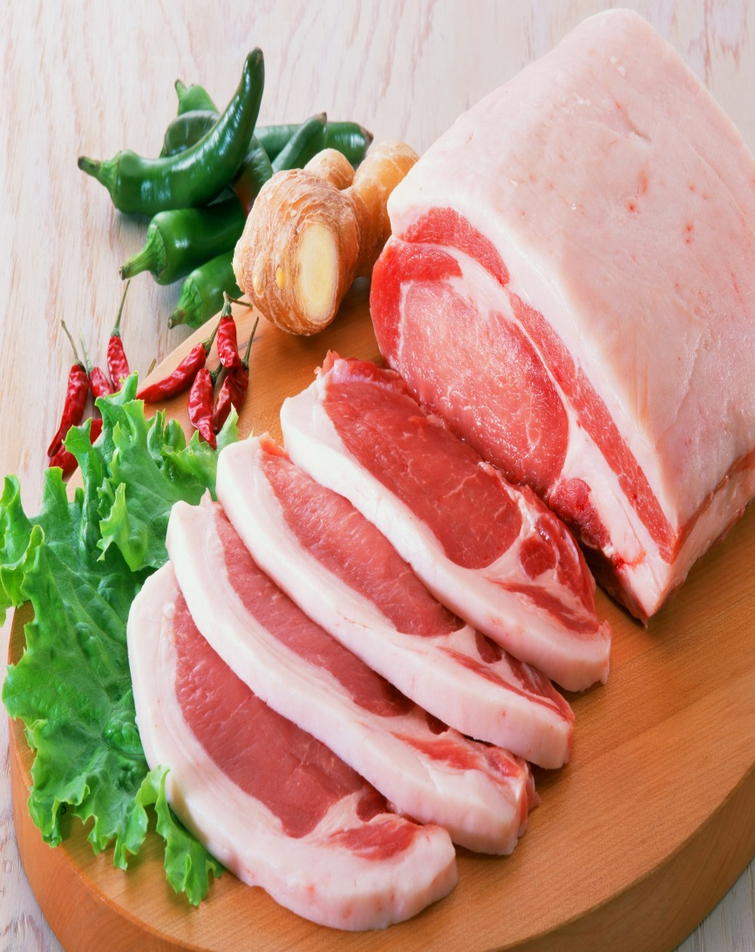
PONTRY

Slide 6
SWEETS

Slide 7
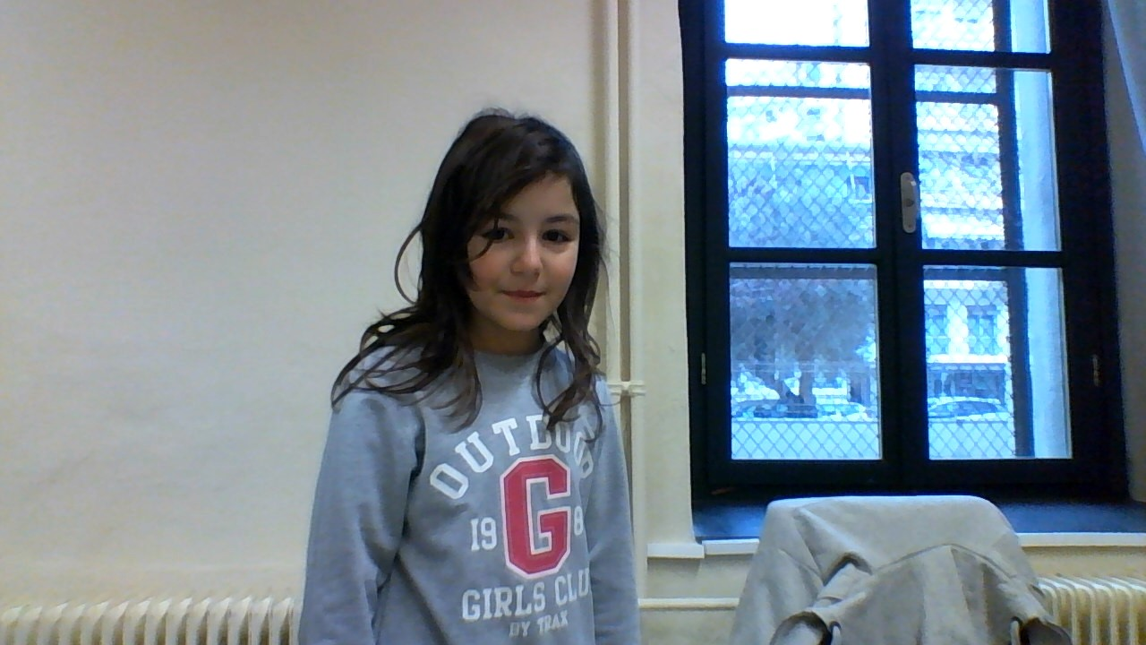
DIMITRA ELENA THEODORA.

