Slide 1
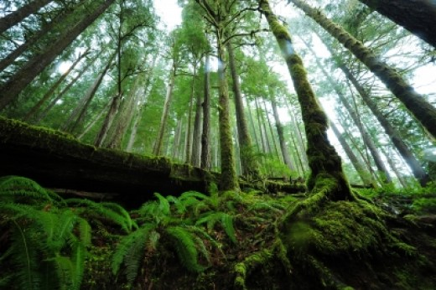
Life in rainforests

Slide 2
Rainforests can be characterized in two words: hot and wet. Mean monthly temperatures exceed 18 °C during all months of the year. Rainforests are forests that experience a high level of rainfall.
Rainforests lie in the tropics (around 28 degrees north or south of the equator). They are found in many areas near the equator such as Asia, Africa, Central America and the Pacific Islands.
The Amazon rainforest is the largest tropical rainforest in the world.
Rainforests used to cover 14% of the Earth’s surface but due to deforestation now only cover around 6%. Tropical rainforests are among the most threatened ecosystems globally due to large-scale fragmentation as a result of human activity.

Slide 3
Rainforests have been called the "world's largest pharmacy", because over one quarter of natural medicines have been discovered within them.
Scientists believe that there may be millions of plant and insect species in rainforests that have yet to be discovered.
Over 25% of natural medicines have been discovered in rainforests.

Slide 5
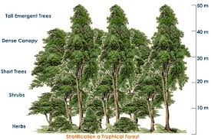
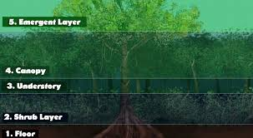
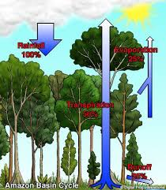

Slide 6
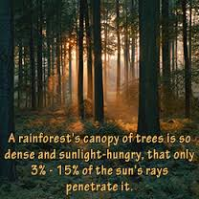
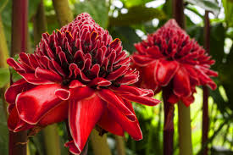
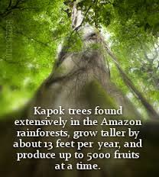
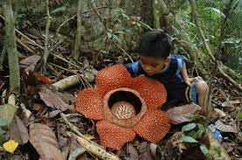
Rainforest flora

Slide 7
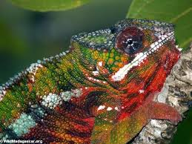
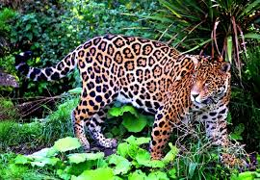
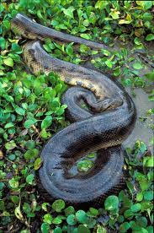
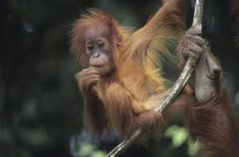
Rainforest fauna

Slide 8
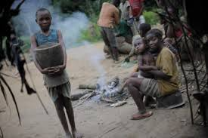
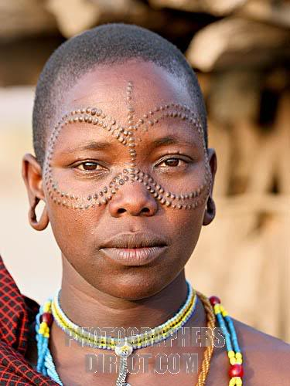
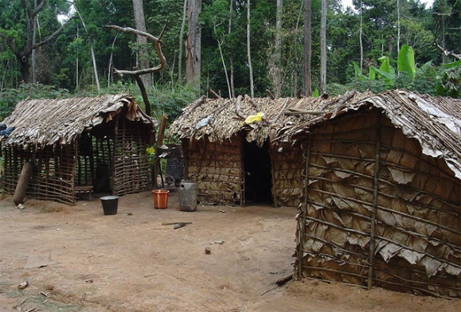
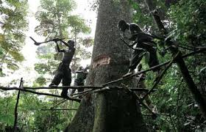
African tribes

Slide 9
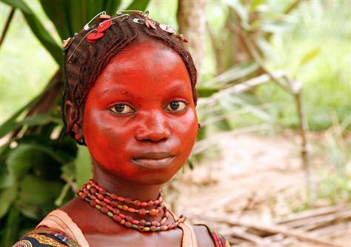
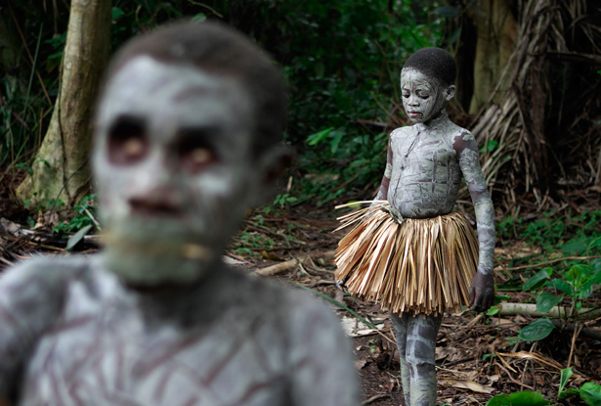
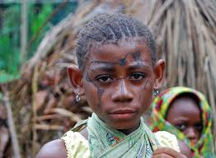
Pygmies
The Pygmies are short (1.45 cm) and light (40 kg) people.
They use branches and tree leaves to make their huts, beds etc. They take out of the forest only what they need and just in the quantity they need it. They live in small groups and they communicate with each other using drums which they make using animal skin. The are active very early in the morning or late in the evening when it’s not so hot and wet.
When they cannot find food, they move (about every two months).

Slide 10
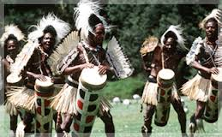
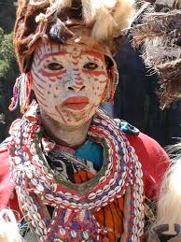
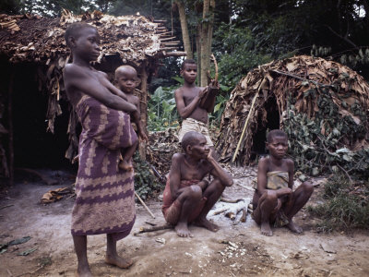
Bandu tribe
The Bandu are farmers. They grow bananas, corn and manioc. They use manioc to make bread.
Every two years they burn trees in small forest areas in order to have more fruitful soil, creating, thus, new fields, i.e. they create new forest areas to cultivate and they move their villages there.

