Slide 1
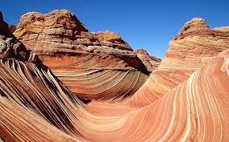
Life in a desert

Slide 2
A desert is a barren area of land where little precipitation occurs and consequently living conditions are hostile for plant and animal life. The lack of vegetation exposes the unprotected surface of the ground to the processes of denudation. About one third of the land surface of the world is arid or semi-arid. This includes much of the polar regions where little precipitation occurs and which are sometimes called "cold deserts".

Slide 3
Distribution of deserts About one third of the land surface of the world is arid or semi-arid. This includes much of the polar regions where little precipitation occurs and which are sometimes called "cold deserts".

Slide 4
Major deserts on earth

Slide 5
Sahara desert
The Sahara (Arabic: الصحراء الكبرى‎, aṣ-Ṣaḥrāʾ al-Kubrā , 'the Great Desert') is the largest subtropical hot desert and third largest desert after Antarctica and theArctic.
Some of the sand dunes can reach 180 metres (590 ft) in height.^{[2]} The name comes from the plural Arabic language word for desert

Slide 6
Sahara desert

Slide 7
Bedouins desert-dwelling Arabian ethnic group

Slide 8
Gobi desert

Slide 9
Oasis isolated area of vegetation in a desert, typically surrounding a spring or similar water source. (flora: date palms)

Slide 10
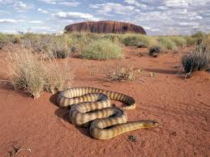
Desert fauna
Fauna in cold deserts
Fauna in hot deserts

Slide 11
Tribes living in deserts are either
a) farmers
or b) breeders (nomads)

Slide 12
Nomads a community of people who live in different locations, moving from one place to another

Slide 13
Consolidation

