Slide 1
Earth relief
All the geomorphologic elements i.e mountains, valleys, lakes, rivers, islands, peninsulas, oceanic basins, trenches etc

Slide 2
The Earth was created 4,6 billions years ago. Its surface has been altering ever since then. Main causes of this continuous change are:
a) endogenous forces (forces acting within the Earth)
b) exogenous forces (forces acting on the surface of the Earth)

Slide 3
Endogenous forces
earthquakes
volcanos
Exogenous forces
wind
water
temperature difference
human intervention

Slide 4
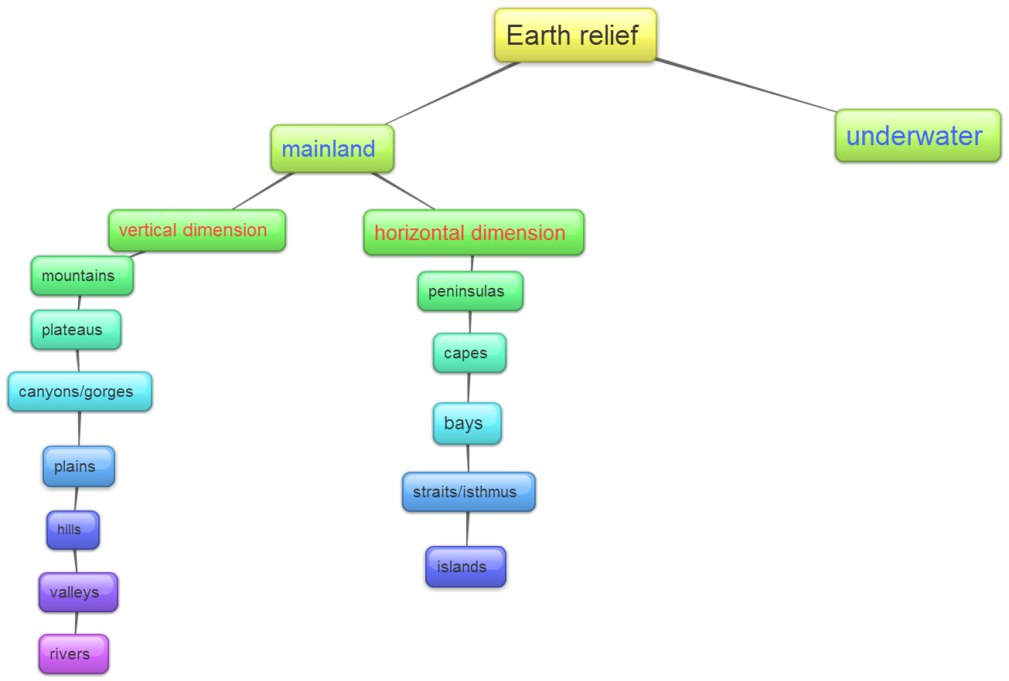

Slide 5
ΕΑRΤΗ RELIEF
Vertical dimension
Estimated average land surface height: 825m
Horizontal dimension
Estimated average oceans depth: 3700m

Slide 6
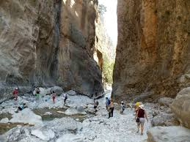
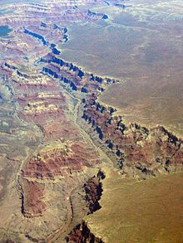
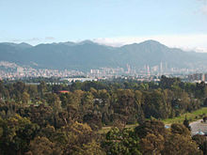
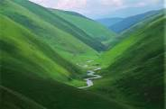
Vertical dimension

Slide 7
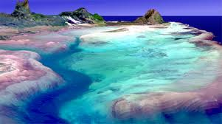
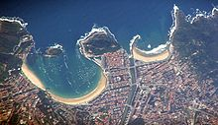
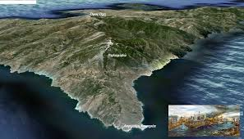
Horizontal dimension

Slide 8
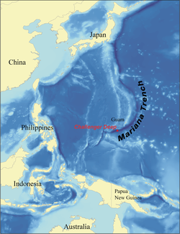
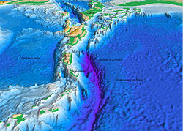
UNDERWATER RELIEF

Slide 9
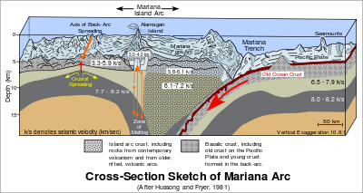
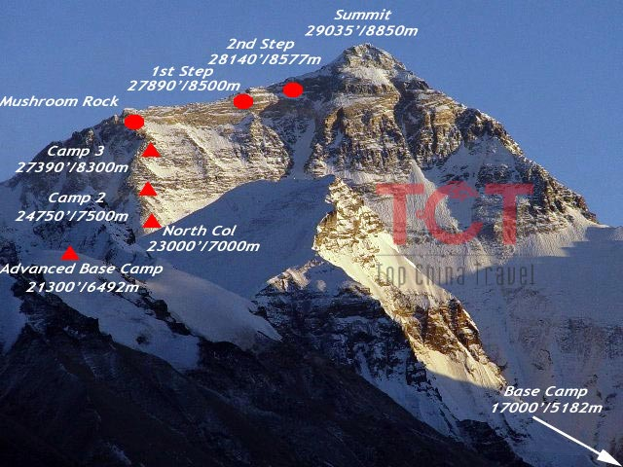
DID YOU KNOW???
Highest peak on earth: 8,848 m above sea level
Deepest part of the world’s oceans: 10,994 km

Slide 10
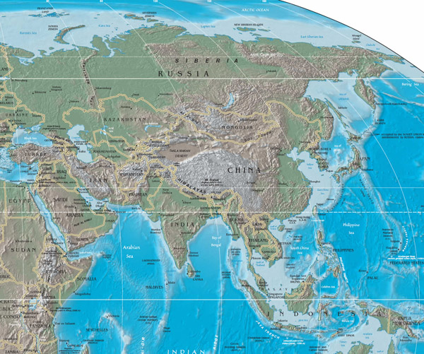
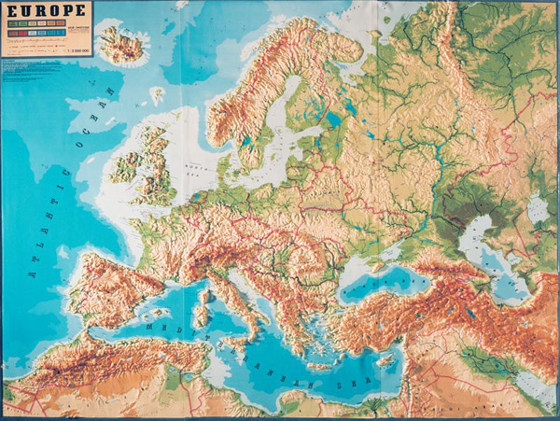
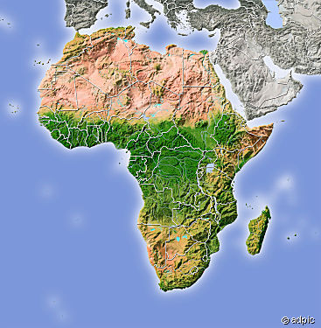
Notes:
Group work: Choose a continent and make a model of the continent relief with plasticine.

