Slide 1
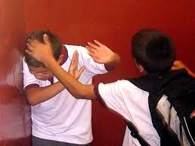
Children’s aggressiveness R. Russel

Slide 2
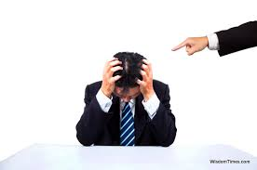
If a child lives in criticism, he learns to criticize

Slide 3
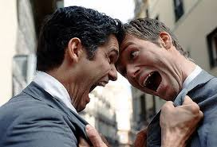
If a child lives in hostility, he learns to quarrel

Slide 4
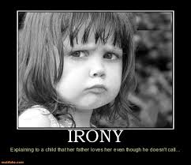
If a child lives in irony, he learns to be shy

Slide 5
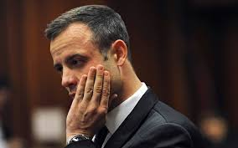
If a child lives in shame, he learns to be quilty

Slide 6
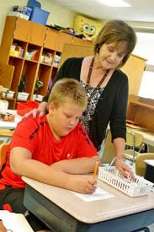
If a child lives in understanding, he learns to be patient

Slide 7
If a child lives in praise, he learns to appreciate

Slide 8
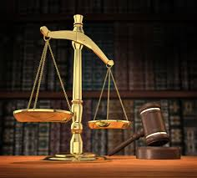
If a child lives in justice, he learns to be fair

Slide 9
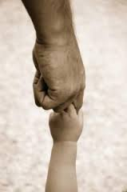
If a child lives in security, he learns to believe

Slide 10
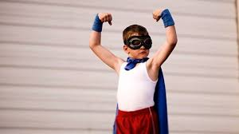
If a child lives in approval, he learns to have self-esteem

Slide 11
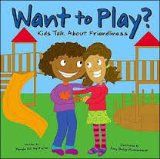
If a child lives in friendliness, he learns to find love in the world

