Slide 1
December 11th

Slide 3
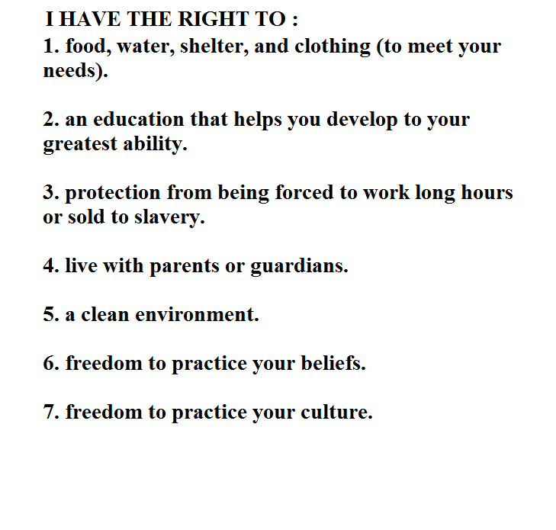
Children’s rights

Slide 4
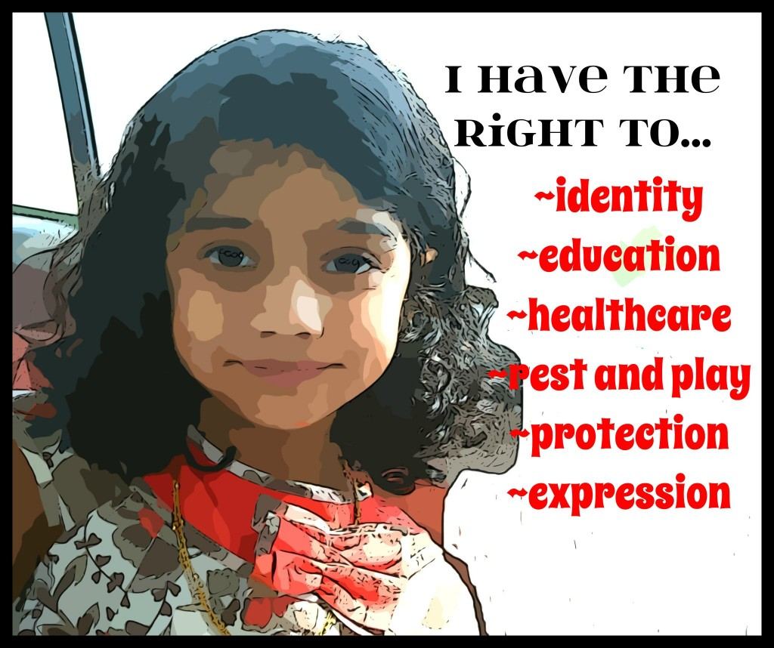

Slide 6
