Slide 1
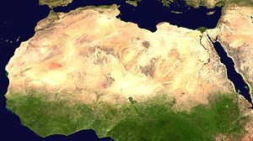
Sahara

Slide 2
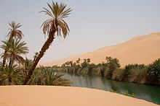
Flora
The Saharan flora comprises around 2800 species of vascular plants . Approximately a quarter of these are endemic . About half of these species are common to the flora of the Arabian deserts. The central Sahara is estimated to include five hundred species of plants, which is extremely low considering the huge extent of the area. Plants such as acacia trees, palms, succulents, spiny shrubs, and grasses have adapted to the arid conditions, by growing lower to avoid water loss by strong winds, by storing water in their thick stems to use it in dry periods, by having long roots that travel horizontally to reach the maximum area of water and to find any surface moisture and by having small thick leaves or needles to prevent water loss by evapo-transpiration.

Slide 3
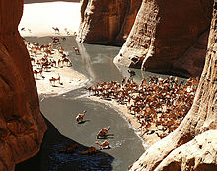
Fauna
Several species of fox live in the Sahara. The Saharan cheetah. Other animals include the monitor lizards , hyrax , sand vipers and small populations of African wild dog. There exist other animals in the Sahara (birds in particular) such as African silverbill and black-faced firefinch , among others. There are also small desert crocodiles. Dromedary camels and goats are the domesticated animals most commonly found in the Sahara.

Slide 4
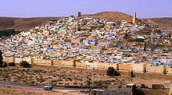
there were breeds such like Nubians , Egyptians , Phoenicians.

Slide 5
Konstantina Kiriakidou

