Slide 1
OCEANS - SEAS

Slide 2
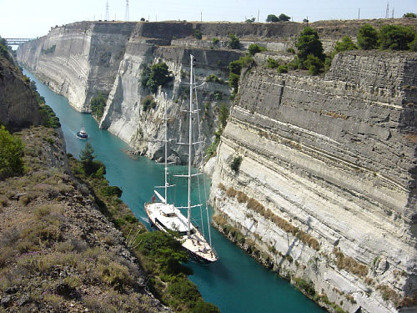
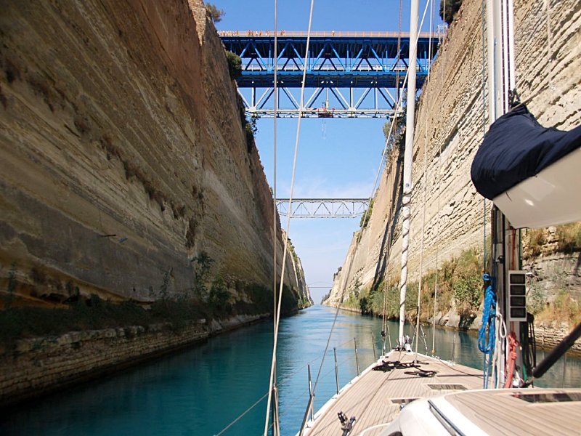
Corinth Canal, Greece

Slide 3
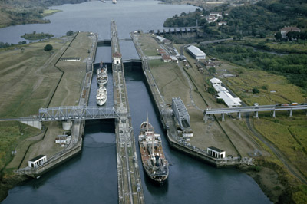
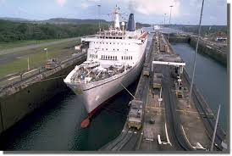
Panama Canal Locks,USA
Notes:
Transit cost: approx. $400,000 for fully loaded (with containers) ships. Cost varies depending on type of ship.
2) Locks raise ships 26 metres due to the 8 inches water level difference between Pacific (which is higher) and Atlantic Ocean.

Slide 4
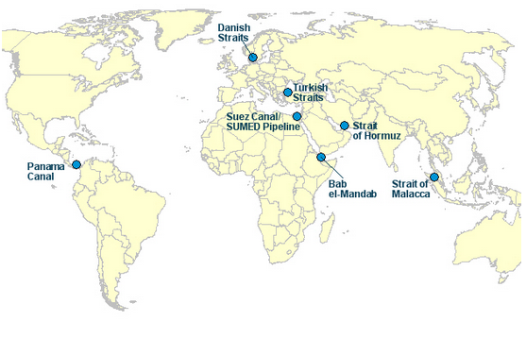
Straits

Slide 5
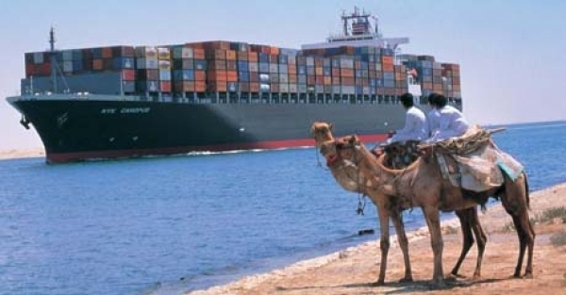
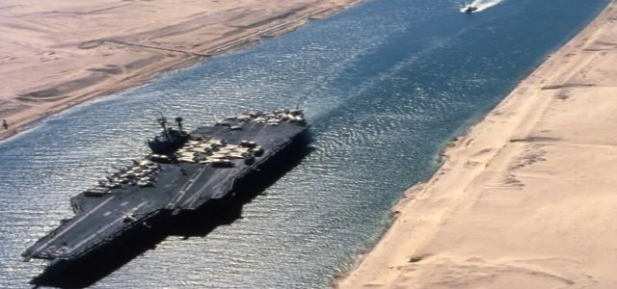
Suez Canal, Egypt

Slide 6
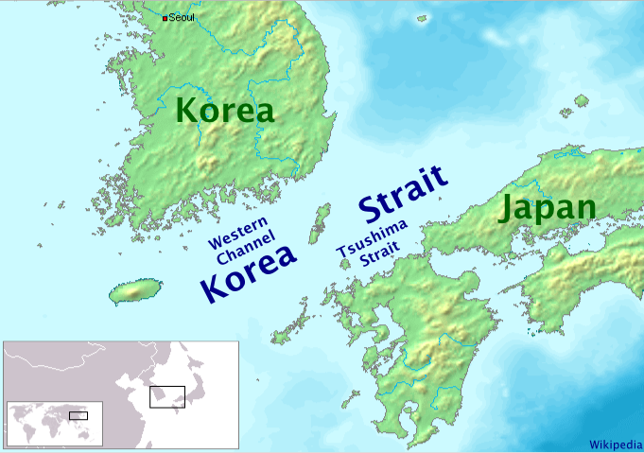
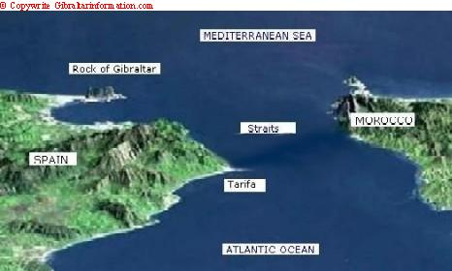
Gibraltar Strait, Portugal
Korea Strait

Slide 7
Do we need canals and straits?
Canals + straits faster and safer sea transport
Notes:
Cause and effect chart

Slide 8
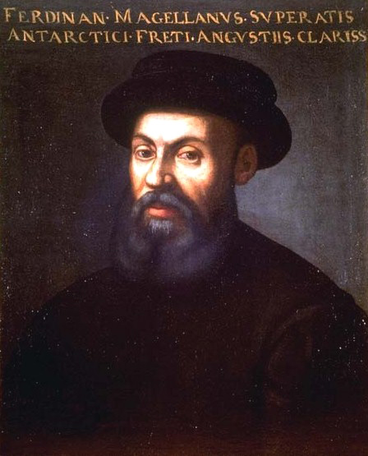
Magellan, Portuguese navigator (1480-1521)

Slide 9
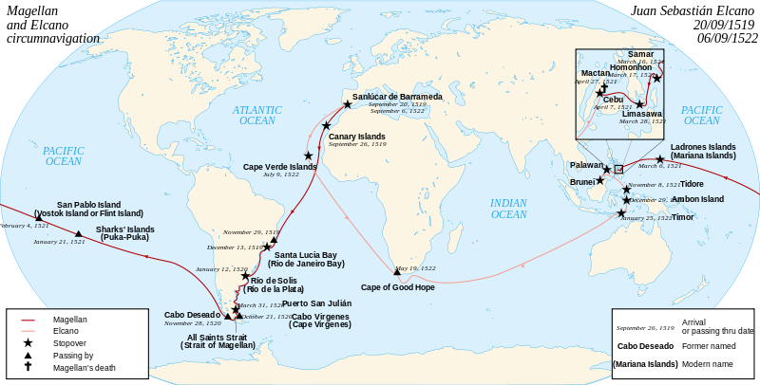
Magellan’s circumnavigation (1522 -1519)

Slide 10
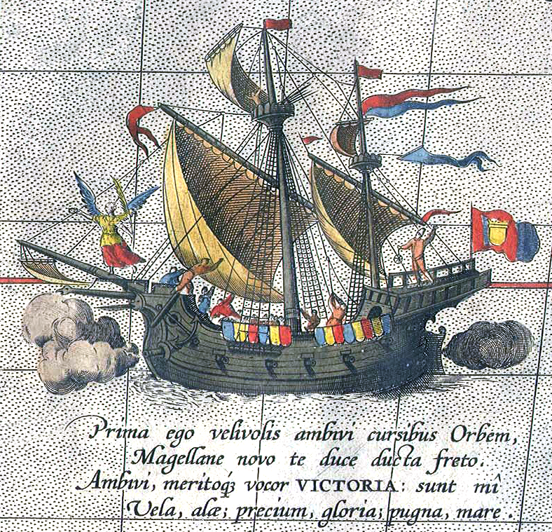
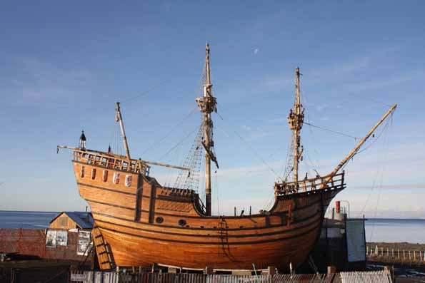
Magellan’s ship Victoria and replica

