Slide 1
Let’s CLIL !!!
Content
Language
Integrated
Learning

Slide 2
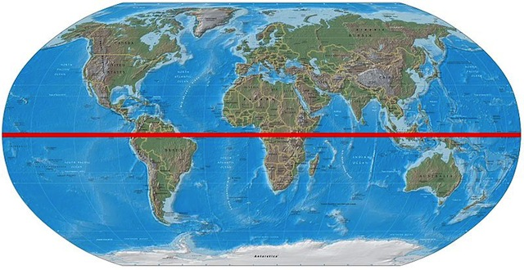

Slide 3
Olympic games emblem

Slide 4
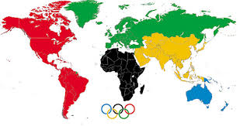
Olympic Games emblem (colors&continents)

Slide 5
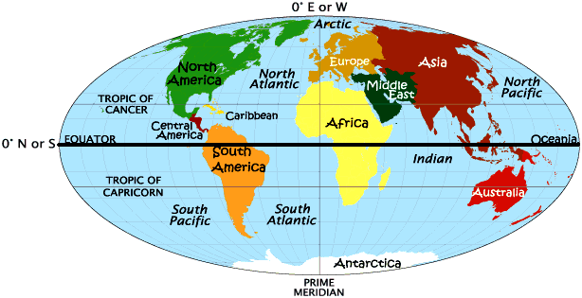
Continents- Oceans distribution

Slide 6
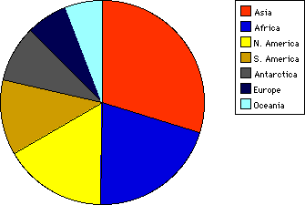
Continents comparison

Slide 7
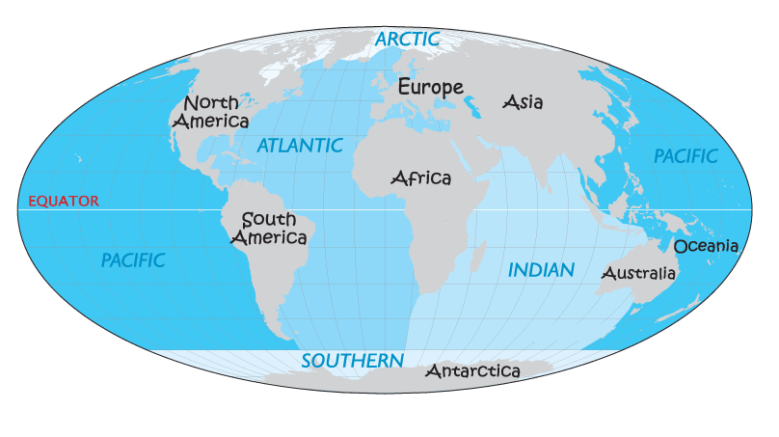
Oceans comparison

Slide 8
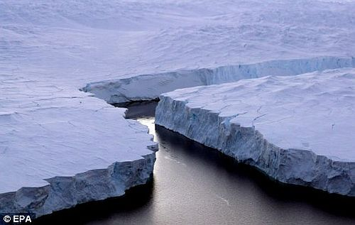
Antarctica ice melting

Slide 9
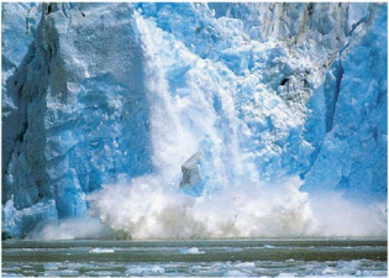
Antarctica ice melting

Slide 10
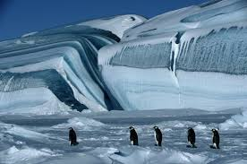
Antarctica ice melting

